Slide 1


Slide 2
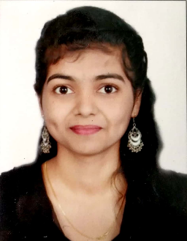

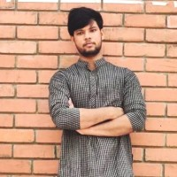
Project Highlights
Project Name : Club Management System
Team Size :
BU Mentor Name :Neha Bandi & Saurabh, Kalpesh, Harshal Trivedi Mentor PS No : 720960
Dhanashree Vinherkar
PS#99002522
2009BLRICP01
B.Tech., E&TC
Arvind Kumar DR
PS#99002493
2009BLRICP01
B.Tech., CSE
Praveen Kumar Chauve
PS#
2009BLRICP01
B.Tech., I&CE

Slide 3
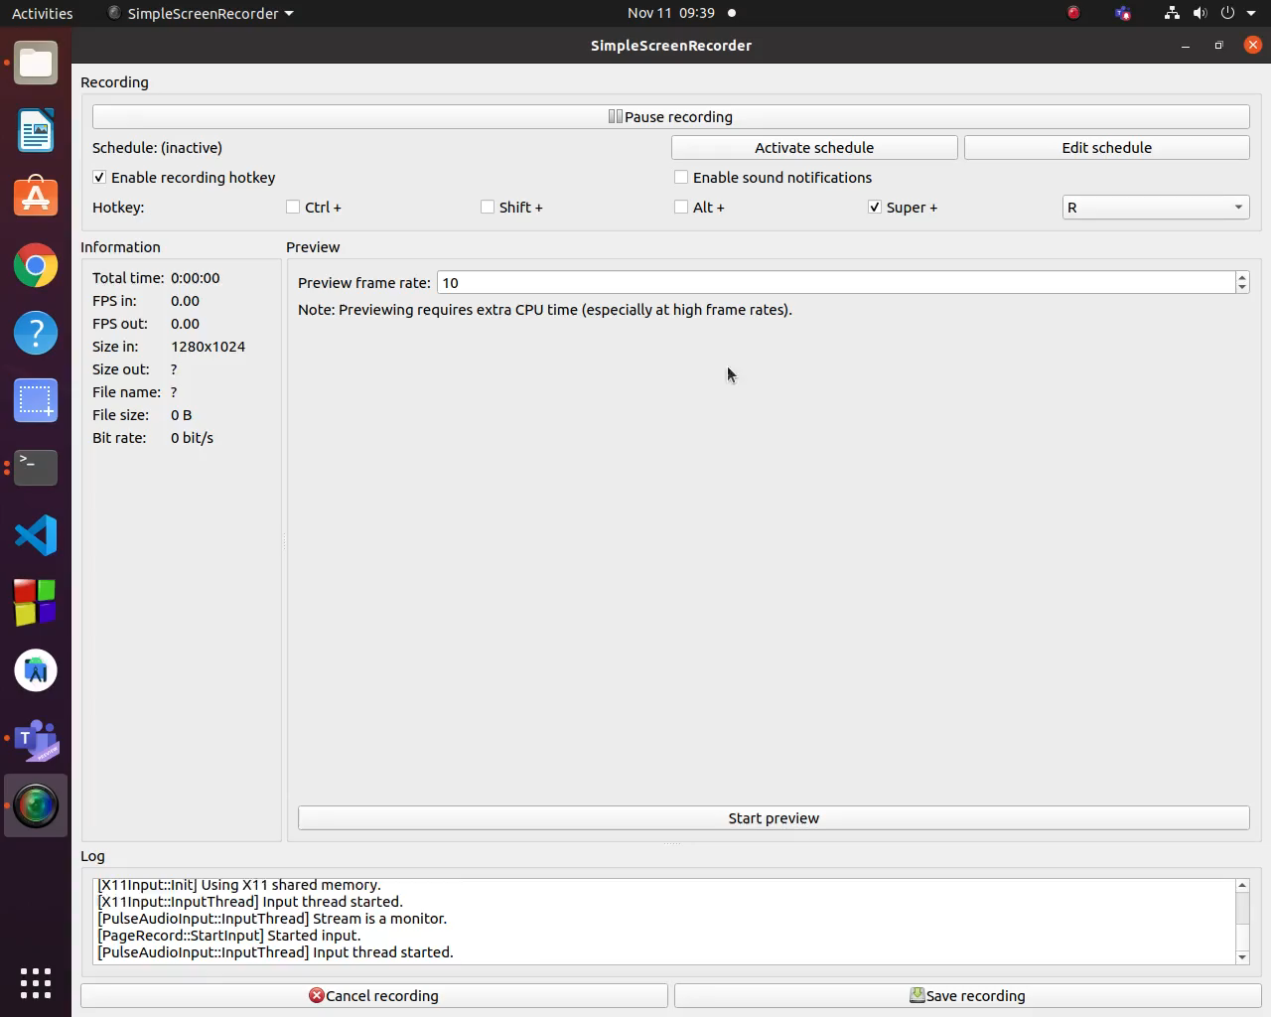
Project Video Snippet

Slide 4
Future development that can be implemented further
Database can be integrated.
Can be implemented using JFRAME for UI feature

Slide 5

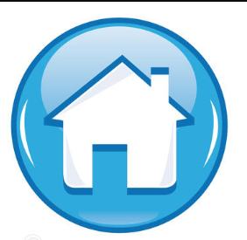
Thank You !

